Slide 1
Guess that pun!

Slide 2
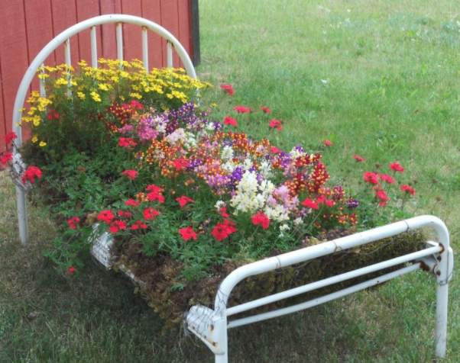

Slide 3
flowerbed

Slide 4
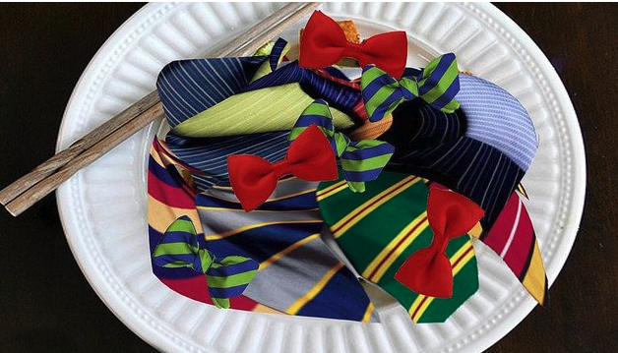

Slide 5
Thai food

Slide 6
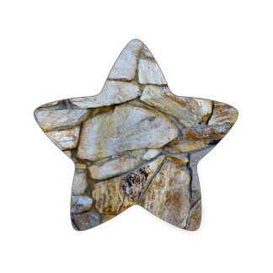

Slide 7
Rockstar

Slide 8
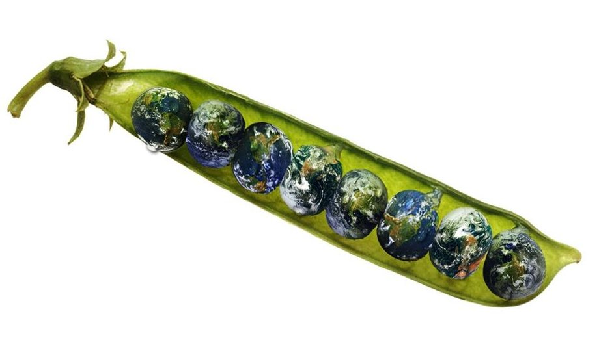

Slide 9
World Peace

Slide 11
Just between me and you

Slide 13
Half baked

Slide 15
An inside job

Slide 17
A play on words

Slide 19
Two steps forward, one step back

Slide 20
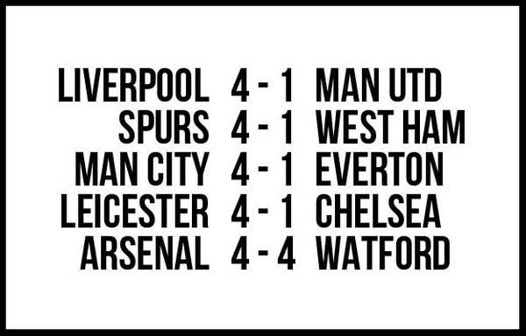

Slide 21
All for one, one for all

Slide 23
Seven seas

Slide 25
Mother-in-law

Slide 27
Always look on the bright side of life

Slide 29
Seven seas

Slide 31
breakfast

